Slide 1
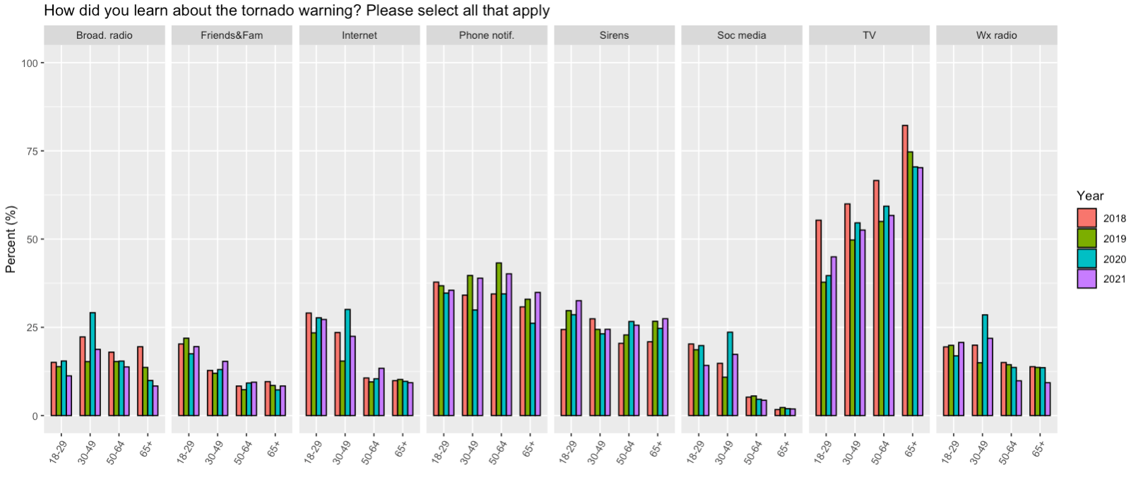
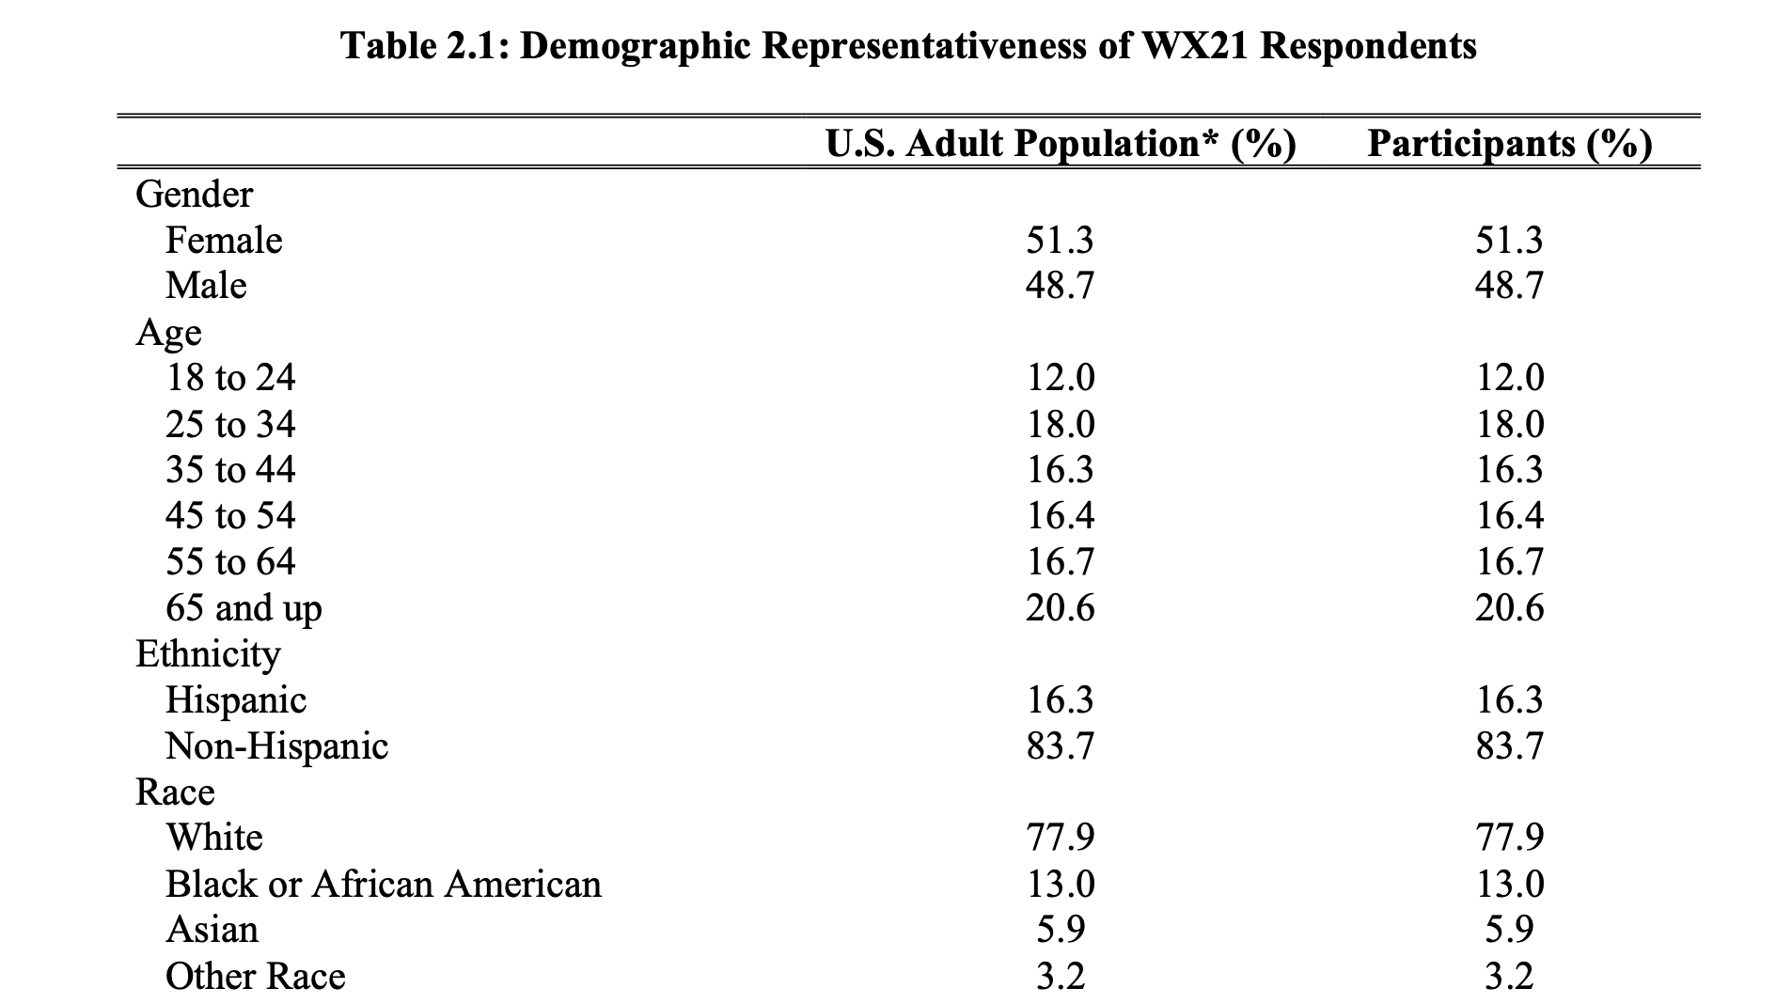
Generational Differences
of Tornado Warning Reception
Rhonda Plofkin¹, Makenzie Krocak^{2,3}, Kodi Berry⁴, Belay Demoz⁵, Jeffrey Halverson⁶
NCAS-M (Cohort 5)¹, OU Institute for Public Policy Research & Analysis², OU CIWRO & NOAA/NWS/SPC³,
NOAA/OAR/NSSL⁴, UMBC/Physics⁵, Dept. Geography & Environmental Systems⁶
Overview
Results
This study analyzed how respondents from different generations answered questions about tornado warning sources from the Extreme Weather and Society Survey.
Extreme Weather and Society Survey
Administered annually beginning in 2017
Survey administered by OU’s Institute for Public Policy Research & Analysis through Qualtrics
Survey questions include baseline and experimental questions
Internet & social media sources decreases as age increases
TV sources increase as age increases
Decreasing trend in Respondents over 50 years old in broadband radio sources
2018 is anomalous with all ages reporting an increase of warning sources from TV
2020 is anomalous in the age group 30-49 reporting warning sources from broadband radio, internet, social medial & weather radio
Methods
Additional Information
Extreme Weather & Society Survey question grouped by age & survey year
(Ripberger et al. 2020)
Data Analysis for Trends
Sources by age group
Age groups through time
Link to Survey Data:
Contact Rhonda:

